Slide 1

Solar Power Generation

Slide 2
Mentors: Karthik Muskula Pallavi Bapuram
Group 5
K. Deepika
Tamalapakula Anunaya
Niharika Sunil Patil
Praveen P
Piyushraj Narsingrao Raut
S. Sai Supriya

Slide 3
objective :
This project focuses on modeling solar power generation using environmental data. The dataset includes 2920 instances with 10 variables, such as temperature, wind speed, sky cover, humidity, and barometric pressure, measured every 3 hours. The goal is to predict solar energy output (in Joules) based on these factors, using exploratory data analysis and regression modeling to identify key influences on solar power generation and optimize predictions under different environmental conditions

Slide 4
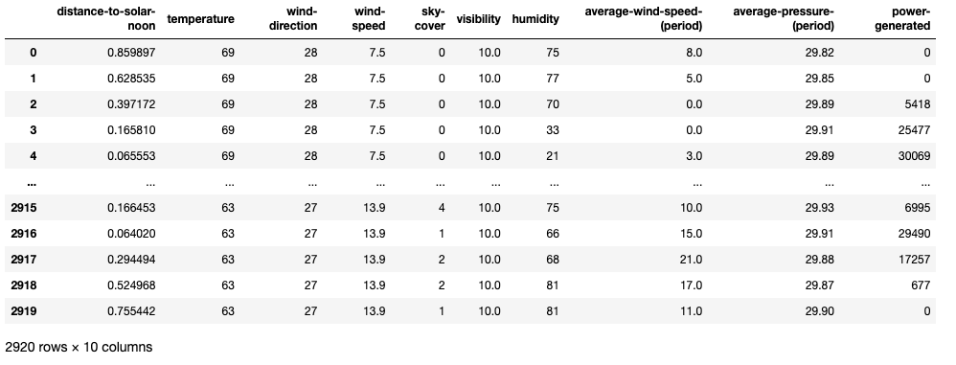
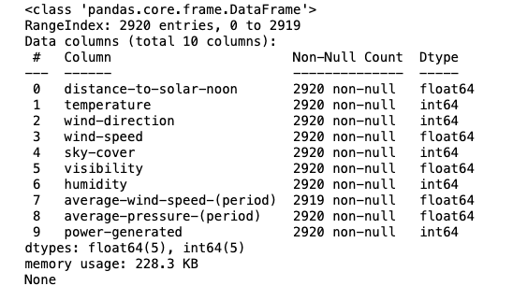
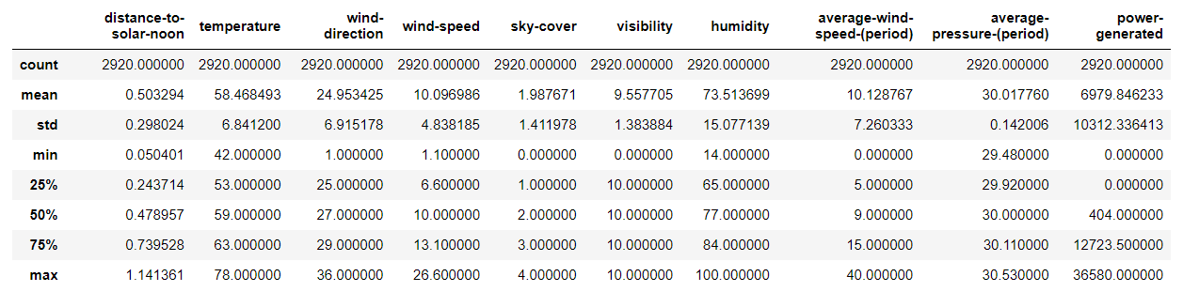
IMPORTING THE GIVEN DATA SET:
BASIC INFORMATION ABOUT THE DATA SET:
DESCRIPTIVE STATISTICS ABOUT THE DATA SET:

Slide 5
EXPLORATORY DATA ANALYSIS:
Here we have done some visualizations like
Histograms
Scatter Plot
Pair Plot
Heat Map
Box Plot

Slide 6
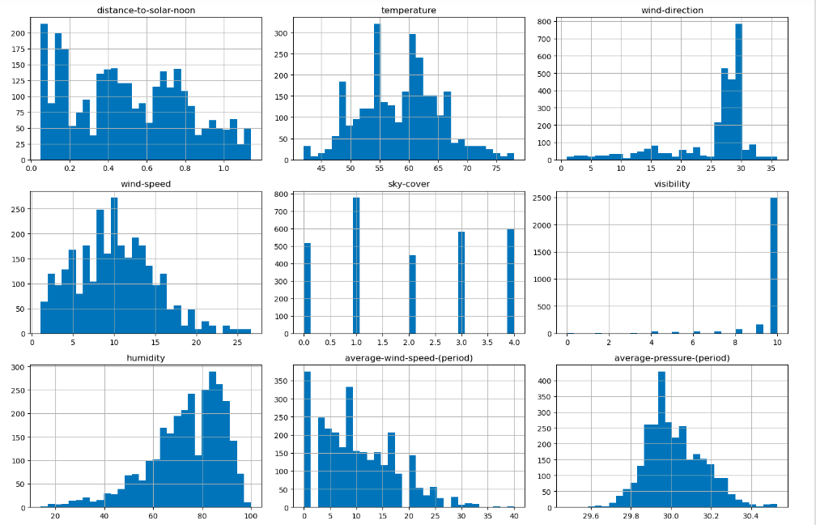
Histogram:
BASIC INFORMATION ABOUT THE DATA SET:
The above data set contains 2920 entries.
There are 10 columns with int& float.
Skewed Distributions: temperature, wind-direction, visibility, humidity, average pressure(period) are skewed to the right. transforming these skewed variables to normalize their distributions for better model performance.
Normally Distributed: wind-speed, average wind speed(period) these may not need transformation.
Variables with Clear Peaks: distance-to-solar-noon, sky-cover these features should be treated differently as they may effect in further processing.

Slide 7
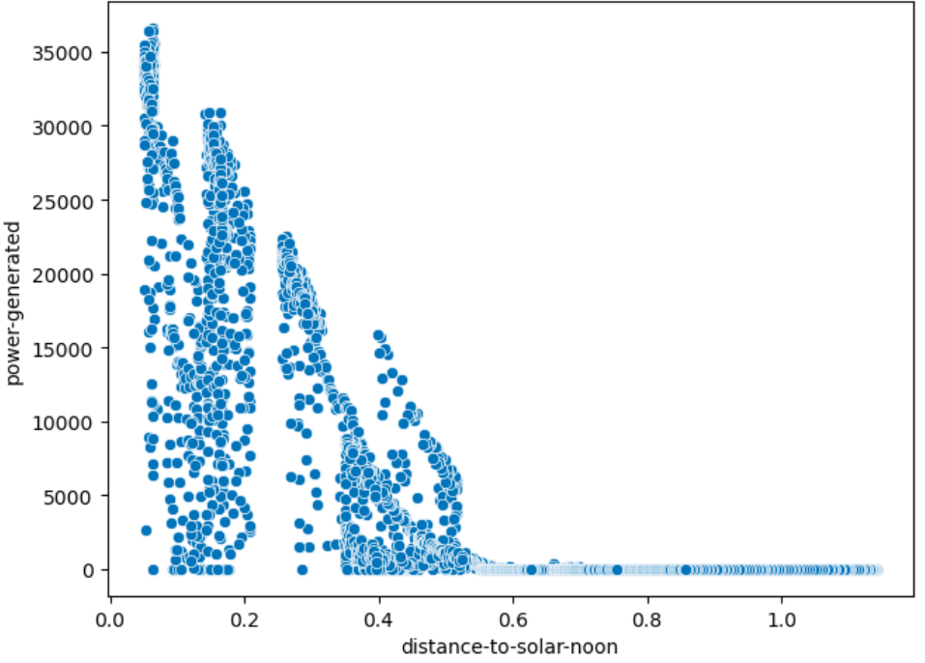
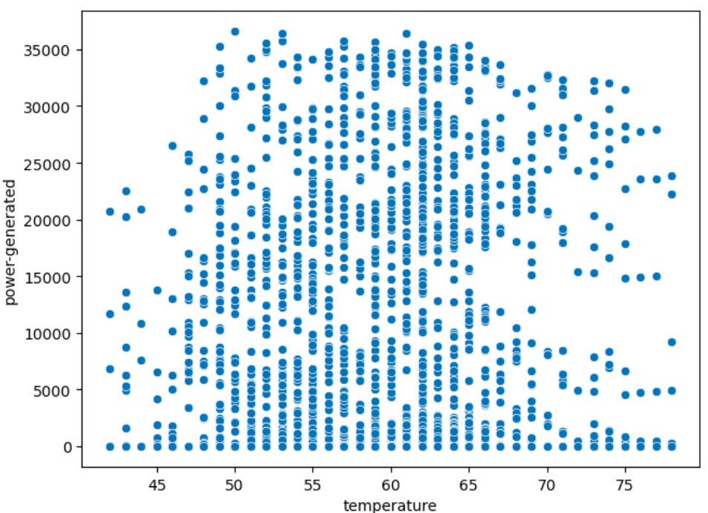
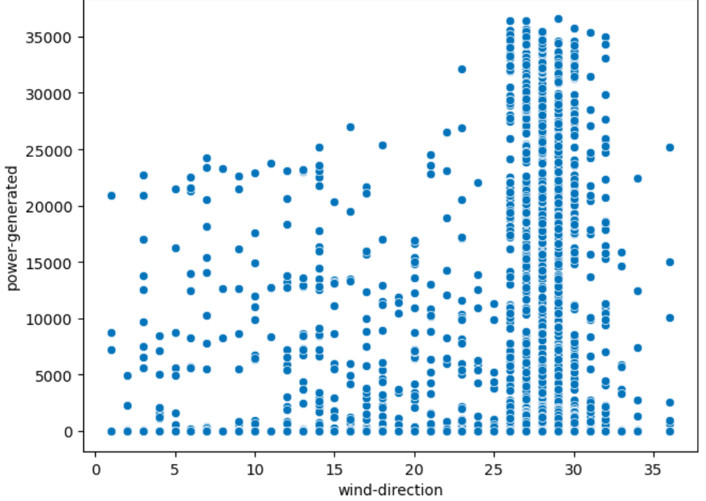
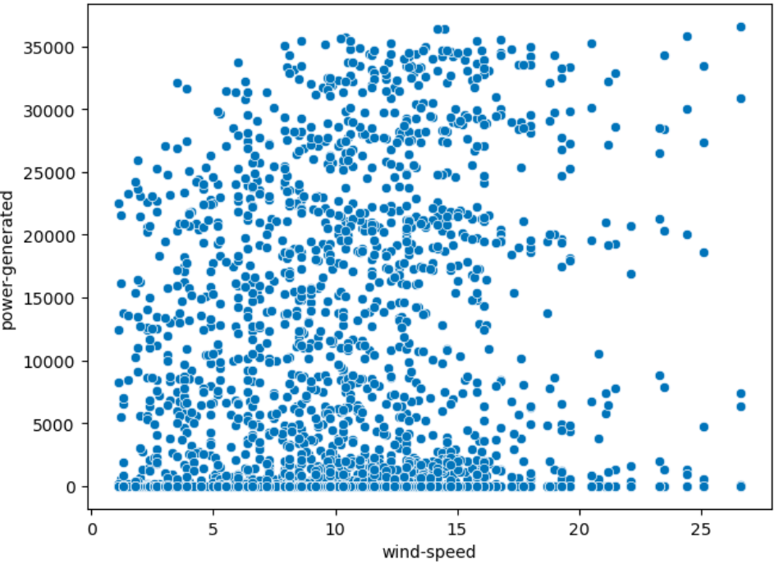
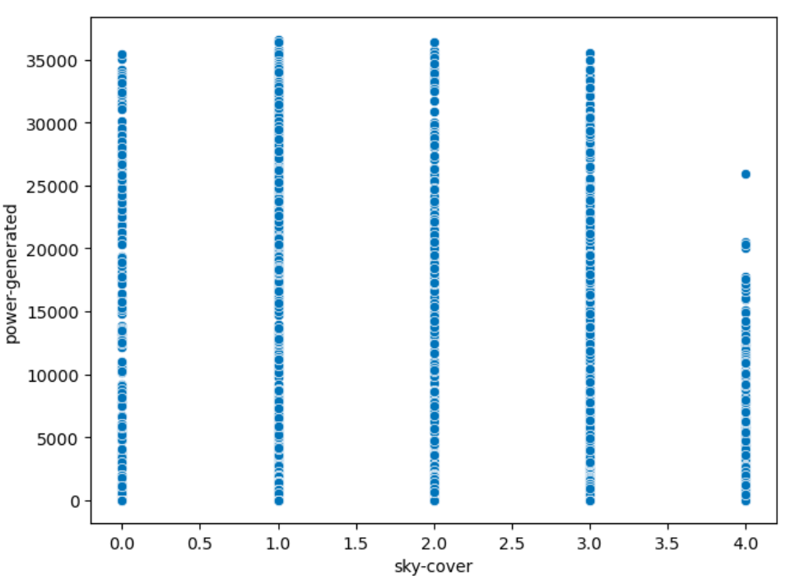
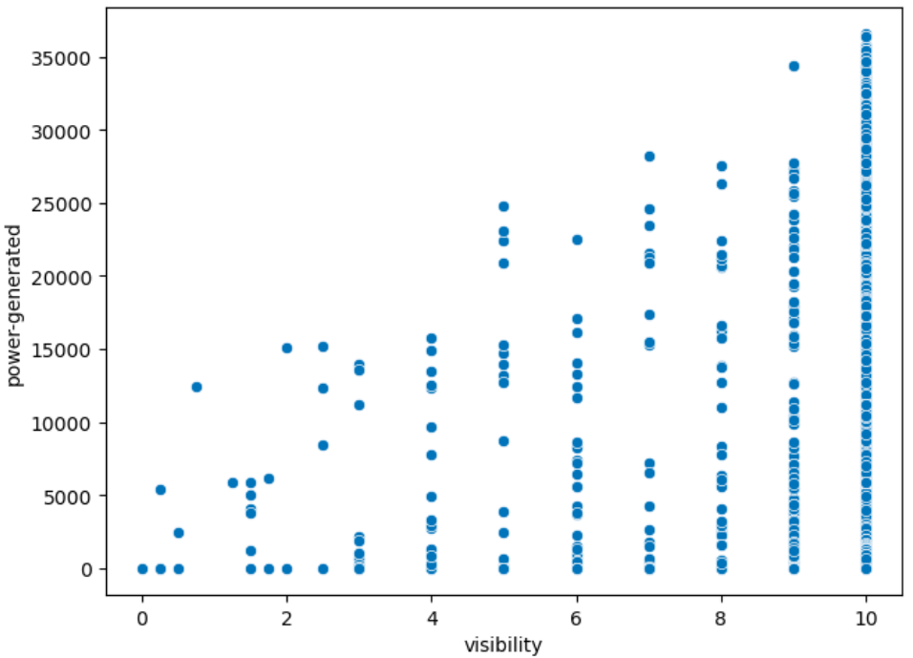
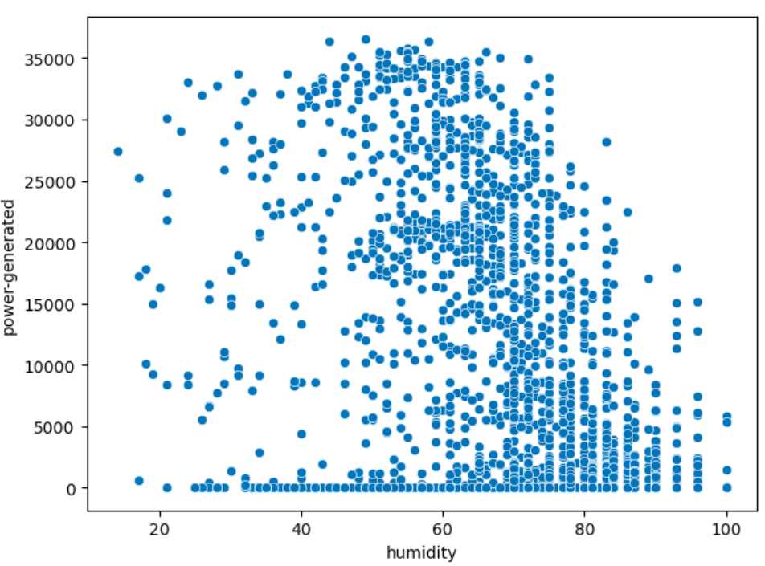
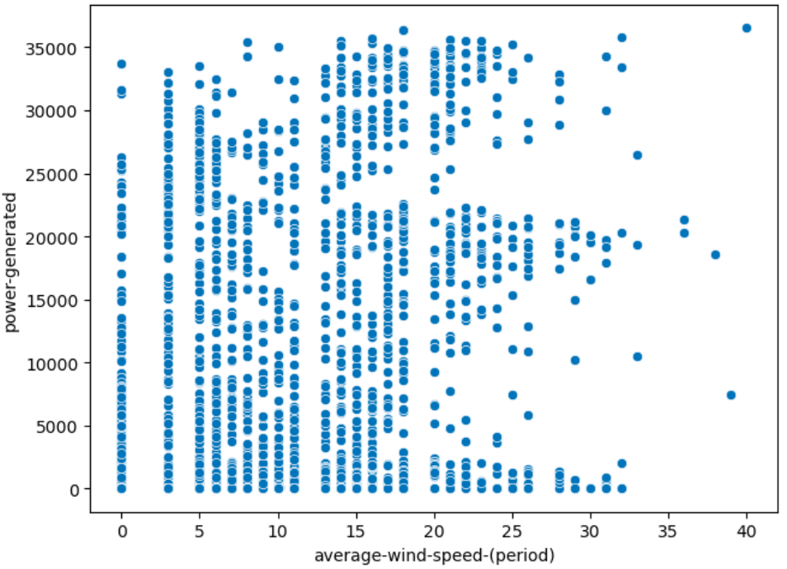
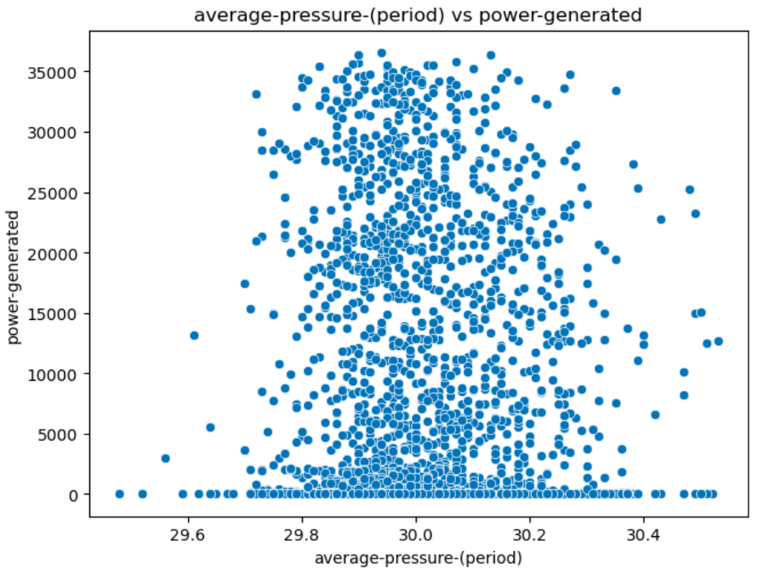
Scatter Plots:
Distance to solar noon and temperature are the strongest predictors of power generation. As expected, power generation increases as the sun approaches closer to noon and is most efficient in moderate temperatures.
Visibility and humidity have weaker but still notable relationships with power generation: higher visibility tends to improve power generation, while higher humidity tends to reduce it.
Wind-direction, wind-speed, wind-average speed and pressure don’t seem to have significant impacts on solar power generation based on the scatter patterns.
Conclusion: For feature selection and modeling focusing more on distance to solar noon, temperature, humidity, and visibility, while wind-related variables may not contribute much predictive value to the model.

Slide 8
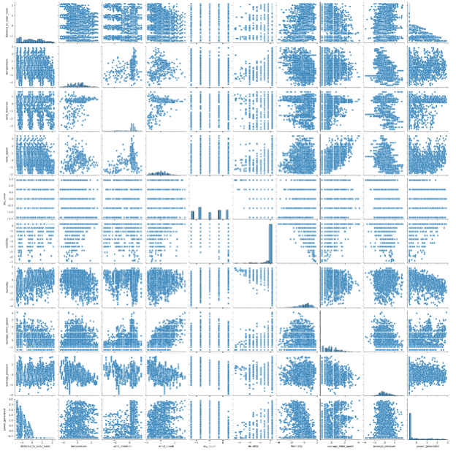
Pair Plots:

Slide 9
Pair Plots insights:
Correlations:
Positive Correlations: temperature and power_generated may show a positive correlation, where higher temperatures lead to more solar power generation.
Negative Correlations: sky cover and power_generated could show a negative correlation, where increased cloud cover results in less solar power generation.
No Correlation: wind_direction, wind_speed and power_generated show no clear pattern and might not directly influence.
Skewed Distribution:
Temperature likely follows a normal distribution (bell-shaped), that most days fall around an average temperature with fewer very hot or very cold days.
Humidity likely skewed.
Outliers: wind_speed and average_wind_speed has outliers representing high or low wind conditions that devite from typical patterns.
Multi-collinear Variables: wind_speed and average_wind_speed likely show high correlation(multi-collinearity).
Non-linear relationship: humidity and power_generated, sky cover and power_generated could show a non-linear relationship.

Slide 10
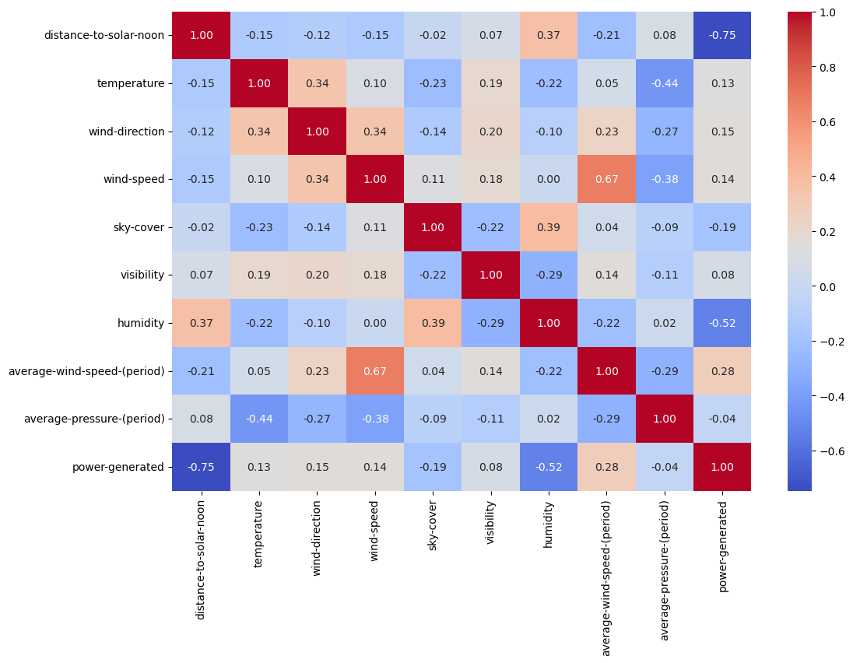
Correlation matrix(Heat map):
Best Predictor:
Distance to solar noon has the strongest relationship with power generated (-0.75). As the sun gets closer to noon, power generation increases.
Moderate Predictors:
Humidity affects power generation negatively (-0.52). Higher humidity leads to lower solar power production.
Average wind speed shows a weak positive correlation (0.28), meaning slightly higher wind speeds might increase power, but it’s not a major factor.
Weak Predictors:
Temperature has a weak positive effect (0.13) on power generation. Moderate temperatures slightly help but aren’t very strong predictors.
Wind speed and wind direction also have small positive impacts (0.14 and 0.15 respectively).
Negligible Predictors:
Visibility, sky cover, and average pressure don’t significantly affect power generation (weak correlations).

Slide 11

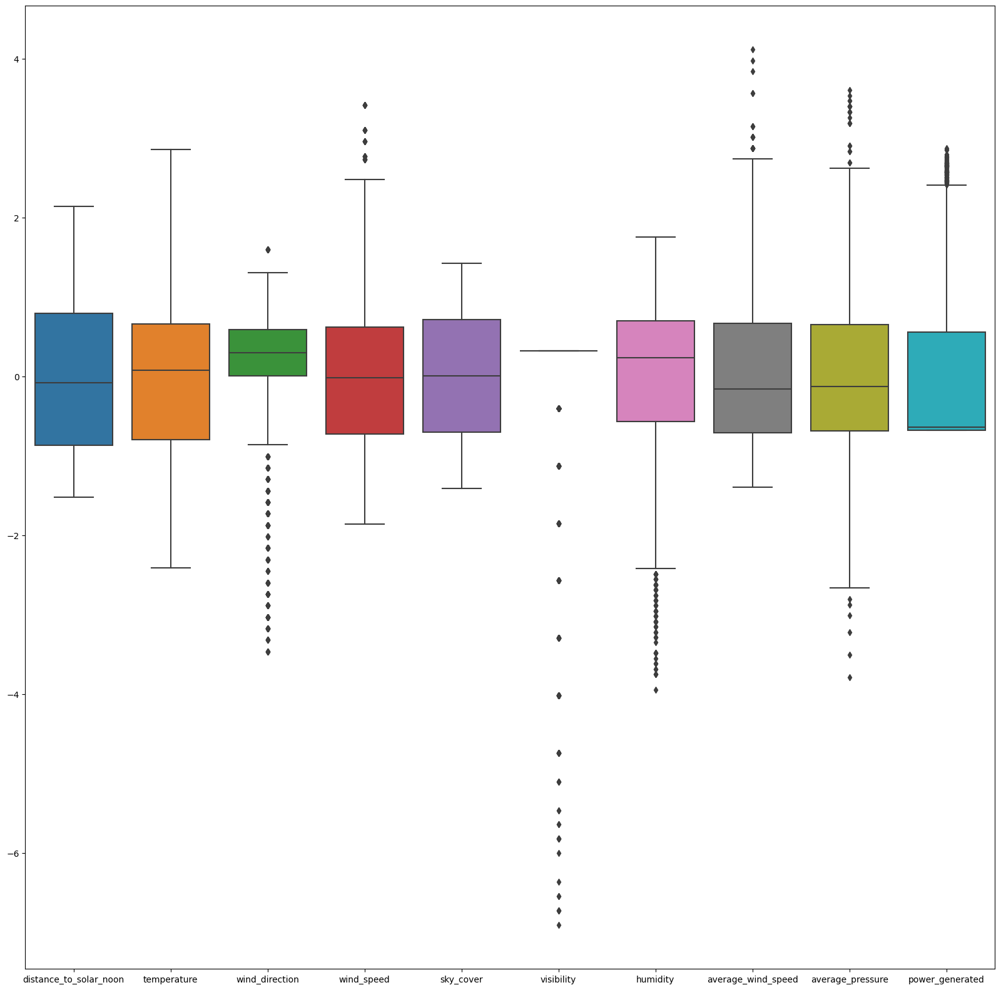
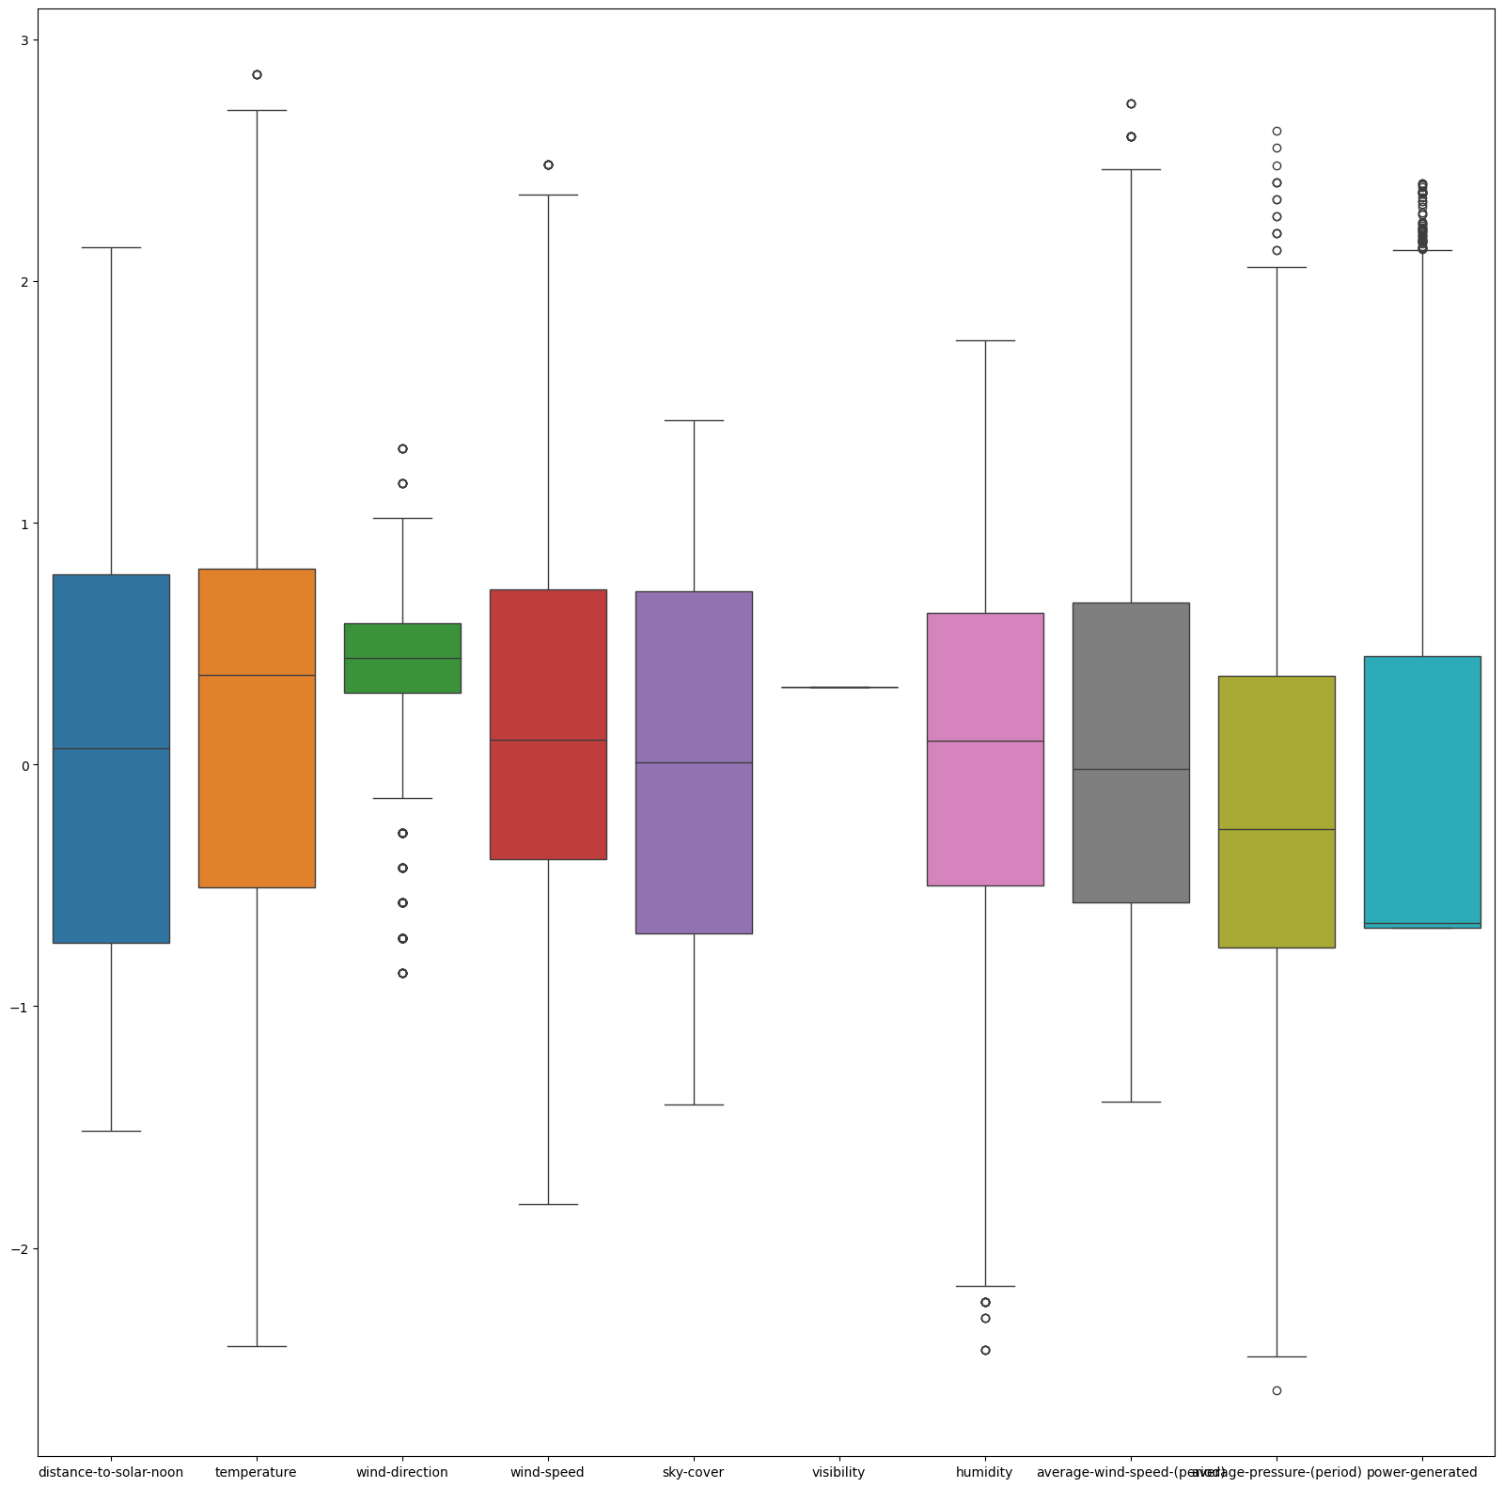
Identifying The Outliers (Boxplot):
BASIC INFORMATION ABOUT THE DATA SET:
Removing the outliers:
The above data set contains 2920 entries.
There are 10 columns with int& float.
Removing outliers is an important step in data preprocessing, especially if you want to ensure that your model isn't skewed by extreme values. There are various methods to remove outliers, but one common approach is to use the Interquartile Range (IQR) method.
The IQR method defines outliers as data points that fall below Q1−1.5×IQRor above Q3+1.5×IQR, where:
Q1 is the first quartile (25th percentile).
Q3 is the third quartile (75th percentile).
IQR is the interquartile range, calculated as Q3−Q1.
Data after Removing Outliers :

Slide 12
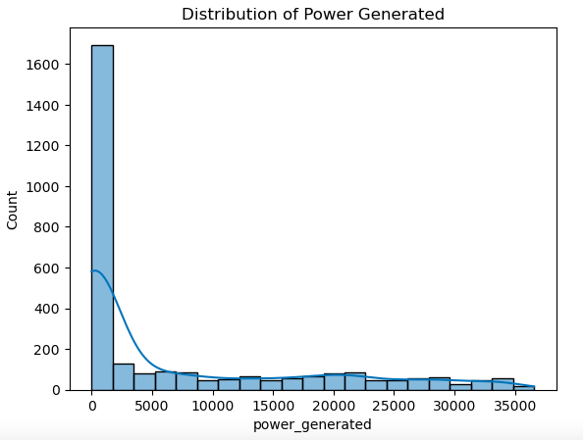
Distribution of the Data:
Skewness of the Distribution: The distribution is heavily right-skewed (positive skew). This suggests that low power generation is much more common, and high power generation events are rare.
Outliers: The few bars on the right side (beyond 25,000) could be considered outliers. These represent rare occasions when solar power generation is exceptionally high, likely under optimal conditions.
Variability: There is a wide range of power generation values in the tail, suggesting high variability in the amount of power generated on different days.

Slide 13
MODEL SELECTION
Linear Regression
Ridge Regression
Lasso Regression
ElasticNetCV Regression
Decision Tree
Random Forest
Support Vector Regressor (SVR)
Gradient Boosting Regressor
XGBoost Regressor
K-Nearest Neighbors Regressor
Bayesian Ridge Regression
Neural Network Regression
Huber Regression

Slide 14
1. Feature Selection and Engineering:
Identify and select the most relevant features from the dataset that will be used to train the model.
Proper feature selection improves model performance by eliminating irrelevant or redundant data, which can reduce overfitting and enhance model interpretability.
2. Splitting the Data:
Split the dataset into training and testing sets.
This step ensures that the model is trained on one subset of data and validated on another to evaluate its performance on unseen data.
Common practice is to split data into 70% for training and 30% for testing, but this can vary.
3. Model Initialization:
Objective: Initialize the Linear Regression model.
Why It's Needed: Linear Regression is a simple and interpretable model, suitable for problems where the relationship between the dependent and independent variables is assumed to be linear.
4. Model Training :
Objective: Train the model using the training data.
Why It's Needed: The model learns the relationship between the features and the target variable during training, adjusting its parameters to minimize the error.
5. Model Prediction:
Objective: Use the trained model to make predictions on the test set.
Why It's Needed: This step helps you evaluate how well the model generalizes to unseen data.

Slide 15
Model Evaluation:
XGBoost: XGBoost is a high-performing model, offering a balance of low error rates and high variance explanation. It's a great choice for this regression task.
Gradient Boost: Gradient Boosting performs on par with XGBoost in terms of overall accuracy. However, XGBoost edges out slightly with a lower MAE, but both are highly effective for this regression task.
Random Forest: Random Forest is competitive with slightly higher overall errors (MSE and RMSE), but its lower MAE indicates more consistent predictions with fewer extreme outliers. It may be preferable if minimizing absolute errors is a priority.
SVR: SVR performs worse than the ensemble models, with both higher errors and lower variance explanation. It may not be the best choice for this task, especially when compared to the boosting methods or Random Forest.
Neural Network: The Neural Network performs the worst among all models, with the highest error metrics and lowest R² score. It is not as well-suited to this regression problem as the ensemble models.
 | MSE | RMSE | MAE | R2
Linear Regression | 0.3715 | 0.6095 | 0.4831 | 0.6251
Ridge Regression | 0.3715 | 0.6095 | 0.4831 | 0.6251
Lasso Regression | 0.3915 | 0.6257 | 0.4922 | 0.6050
ElasticNetCv Regression | 0.3714 | 0.6094 | 0.4830 | 0.6252
Decision Tree | 0.1831 | 0.4280 | 0.1938 | 0.8152
Random Forest | 0.1090 | 0.3301 | 0.1502 | 0.8900
Support Vector Regressor | 0.1229 | 0.3506 | 0.2025 | 0.8760
Gradient Boost | 0.0984 | 0.3136 | 0.1632 | 0.9007
XGBoost Regressor | 0.0982 | 0.3134 | 0.1572 | 0.9009
K-Nearest Neighbors | 0.1830 | 0.4277 | 0.2410 | 0.8154
Bayesian Ridge Regressor | 0.3715 | 0.6095 | 0.4830 | 0.6250
Neural Network | 0.1318 | 0.3630 | 0.2018 | 0.8670
Huber Regression | 0.3792 | 0.6158 | 0.4721 | 0.6173
BASIC INFORMATION ABOUT THE DATA SET:
The above data set contains 2920 entries.
There are 10 columns with int& float.

Slide 16
Model Evaluation:
XGBoost is the best model for this dataset because:
XGBoost shows strong performance with low MSE and RMSE, indicating good overall accuracy.
The MAE is also relatively low, meaning it has smaller average errors compared to other models.
With an R² of 0.9009, XGBoost explains about 90% of the variance in the target variable, making it a reliable model for regression tasks.
It offers high predictive performance and efficiency.
It can handle medium-sized datasets (like the solar power generation dataset) with complex, non-linear patterns.
It’s robust to overfitting due to built-in regularization.
It’s optimized for speed and can handle missing data effectively.

Slide 17
Model Deployment : (XGBoost Regressor)
Installation of Streamlit
Converting jupyter notebook into a python file.
Refactor code for Streamlit:
Import Libraries: Import Streamlit and necessary libraries
App Layout: To add titles, sidebar elements, file uploaders, etc.
File Uploader: To upload required files.
Interactive Widgets: Use sliders, button, and other widgets to control data inputs.
Displaying Plots: To display matplotlib or seaborn visualizations.
Perform Analysis and Display Results: Write data analysis and display results using Streamlit.
Run Streamlit in the command line to navigate to the folder containing python script and run. This will launch a local Streamlit web server
Link for Deployment:
https://solarpowergenration-kthhbspxjgmwunnrn4h3gz.streamlit.app/
Deploy using Streamlit.

Slide 18
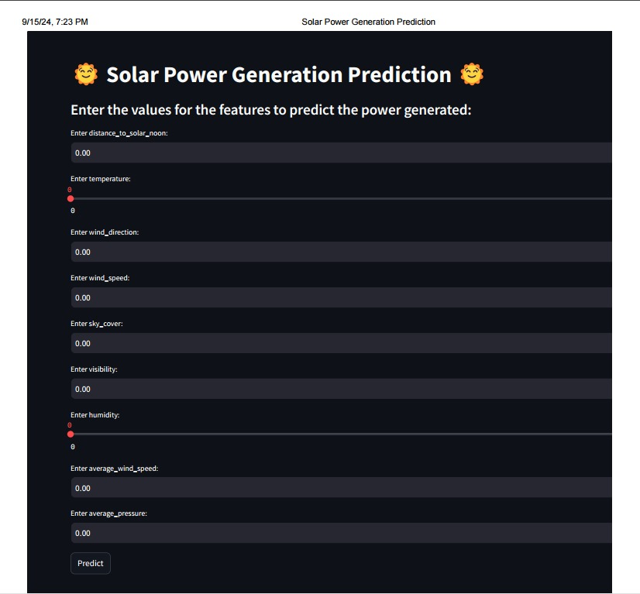
Deployment:
:

Slide 19
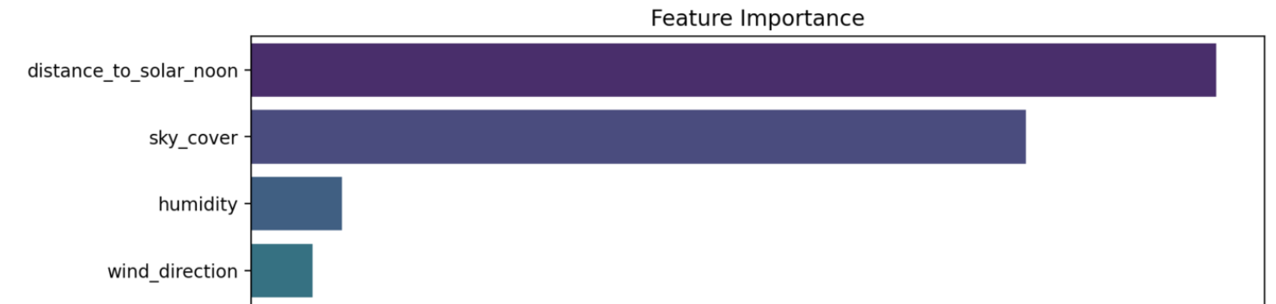
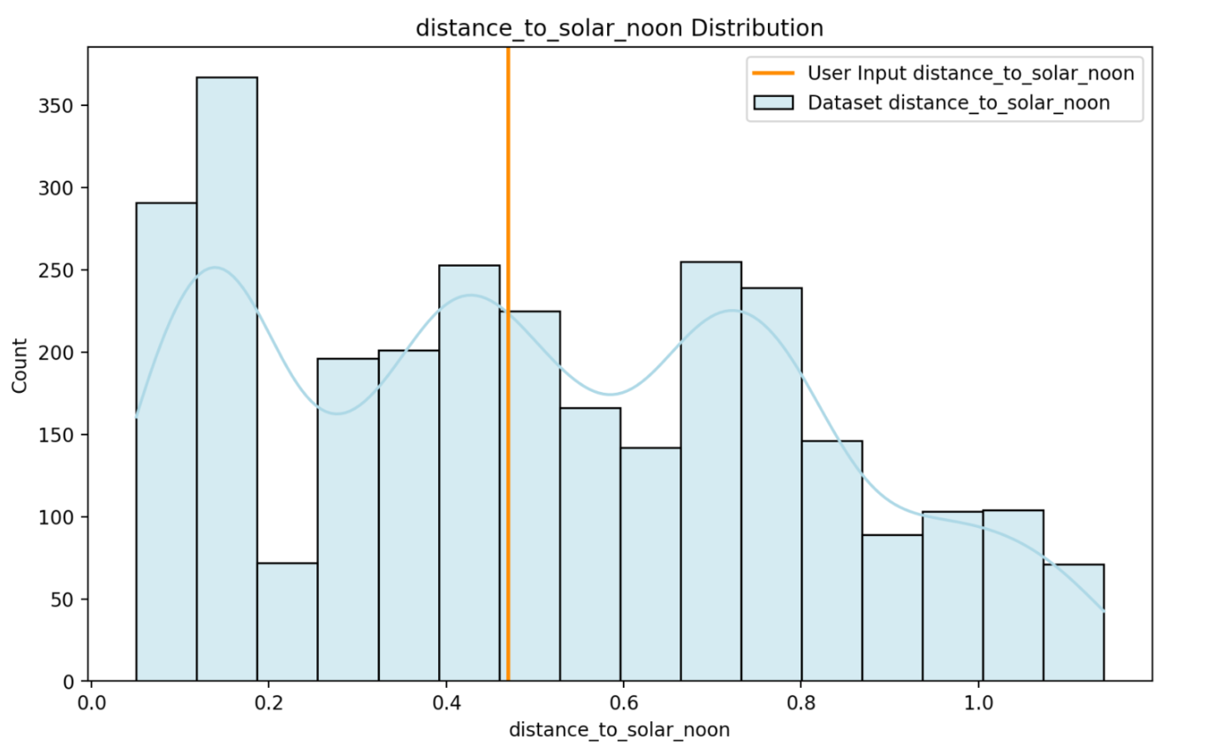
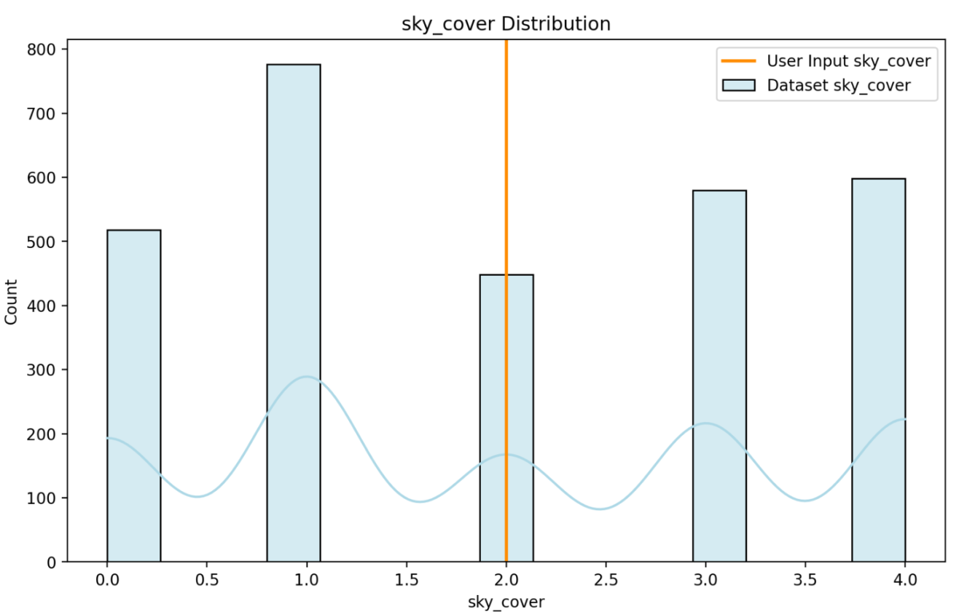
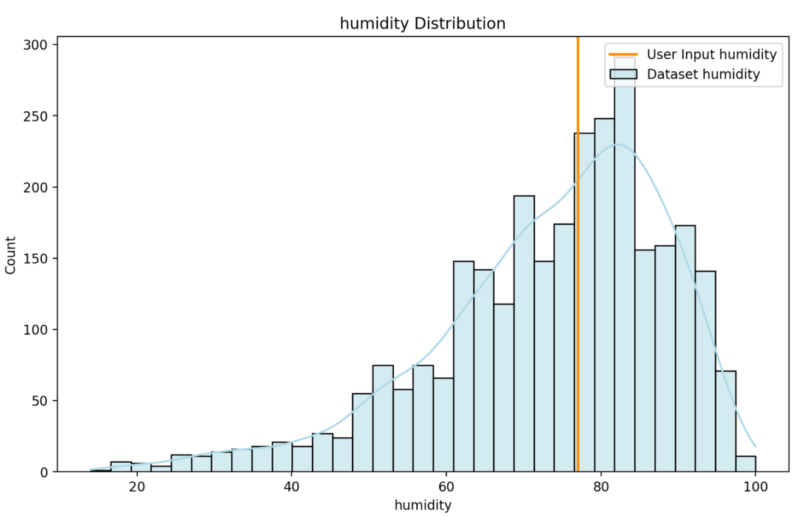
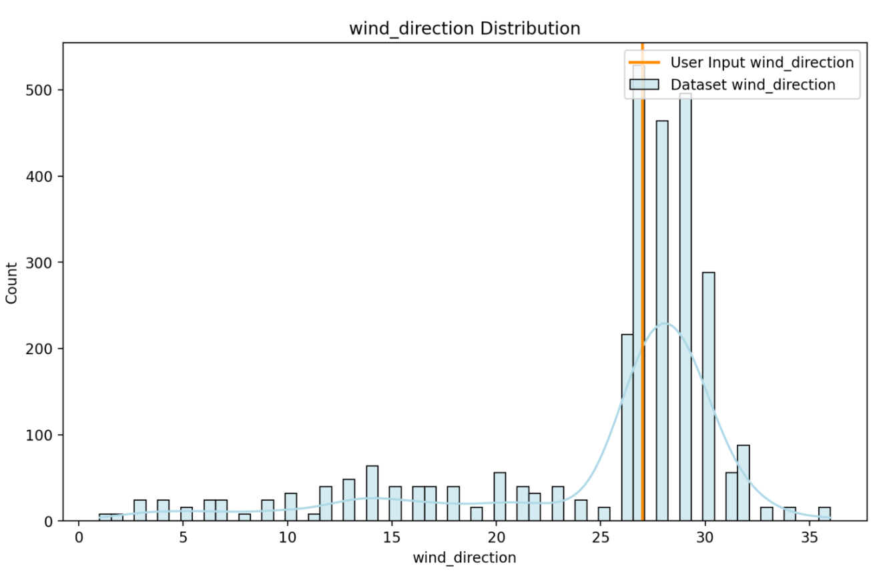
Predicted Power Generated: 2388.78 Watts (W)
Feature Importance:
The model places high importance on variables related to sunlight exposure (e.g., distance to solar noon and sky cover) while assigning less importance to atmospheric conditions (humidity and wind direction).
User Input vs Dataset Distribution:
Distance to Solar Noon:
The user input falls slightly above 0.5. The user input for distance to solar noon is relatively average, which aligns well with the majority of the dataset.
Sky Cover:
The user input for sky cover is around 2.0. The user input represents a moderately cloudy condition, which is not extreme but relatively common in the dataset.
Humidity:
The users input is around 50 on the humidity scale. The majority of data points are concentrated between 40-80% humidity.
The humidity value provided by the user is typical and falls within the average range of the dataset.
Wind Direction:
The user input is close to 0 on the wind direction scale. The user input falls within a low wind direction value, but the distribution suggests that there may be clusters in specific directions, which are more common in the dataset.

Slide 20
Prediction Explanation:
The prediction is based on the following features you have entered:
Distance to Solar Noon: Affects the angle of sunlight reaching the panels.
Wind Direction: Influences the cooling of solar panels and their efficiency.
Wind Speed: Affects cooling and energy generation efficiency.
Sky Cover: Determines the amount of sunlight reaching the panels.
Average Wind Speed (Period): Averages wind speed over a certain period.
Average Pressure (Period): Influences weather patterns affecting solar radiation.

Slide 21
Overall Conclusion:
The deployment results show that the user's inputs are within average or common ranges of the dataset. The model relies heavily on features related to solar exposure (distance to solar noon and sky cover), which align well with the user-provided inputs. This results in a predicted power generation of 2388.78 Watts, which seems reasonable given the moderate weather conditions represented by the input values.

Slide 22
Solutions
Challenges
Coordination and Availability
Outliers in the data as it could skew the model results.
Dealing with standardization features like SVR and Neural networks.
Feature Selection identifying which feature had the most impact.
Best model selection for predicting.
Deploying Streamlit code after model development, deploying the model.
Decision-Making and communication
Using IQR method to detect and remove the outliers.
Applied standard scaler to scale and for better performance
Conducted correlation analysis and feature visualization like scatter plots, heatmaps, etc.
Tried different models and compared their MSE, RMSE, MAE, and R².
Streamlit was chosen for deployment due to its ability.

Slide 23
THANK YOU

